Slide 1


EIP Security Architecture
Requirements & Design Specification
Innovate
value-focused
digital & data solutions
At Speed.
Harmonize
alignment-focused organizational functions
At Scale.
Execute
customer-focused experiential services
With Confidence.

Slide 2

Enterprise Data Platform (EDP)
Security Requirements & Design Specification

Slide 3
EIP Security Architecture: Physical & Digital Assets Security Layers
Policies & Processes
Enterprise standard Security Policies & Process to ensure Confidentiality, Integrity, Compliance, Non-Repudiation & Availability.
Physical Perimeter Security
Deny Unauthorized Access to Facilities to Protect Personnel, Assets & Resources using Protective Barriers, Surveillance Intrusion Detection & Access Controls
Network Security
Prevent & Detect Unauthorized Access, Changes, Misuse, or Denial Of A Computer Network Or Any Networked Computing Resources to Protect Digital Assets
Operating Host Security
Prevent, Monitor & Detect Unauthorized Access, Changes, Misuse, or Denial Of Computing Resources to Protect Digital Assets
Application Security
Prevent & Detect Security Holes/Gaps Throughout SDLC & Unauthorized Access, Changes, Misuse, or Denial Of Applications to Protect Digital Assets
Data
Security
Prevent, Detect, & Monitor Unauthorized Access, Changes, Misuse, Denial, Corruption Or Loss Of Data To Protect Privacy, Integrity & Regulatory Compliance Of Sensitive Digital & Data Assets

Slide 4
EIP Security Architecture: Reference Service Model
Application Services
Application Service Components
Authenticate & Authorize
Encrypt & Decrypt
Access Protected
Application Resources
Security Services
Identity Management Services
User Lifecycle Management
Credential Management
Entitlements Management
Identity Attestation
Provisioning Services
Self-Service
Delegation Administration
Synchronization & Reconciliation
Access Management Services
Authentication
Authorization
Single Sign On
Multifactor Authentication
Session Management
Security Token Service
Identity Federation
Security Auditing
Data Protection & Encryption Services
Key Management
Encryption
Decryption
Tokenization
Masking
Audit
Audit, Compliance & Reporting Services
Logging & Auditing
Reporting & Dashboarding
Compliance Management
Analytics & Decision Management
Security Stores
Identifiers
Credentials
Core Attributes
Identify Store
Security Policies
Access Rights &
Privileges
Entitlement Store
Encryption Keys
Private & Public Keys
Certificates
Key & Trust Store
Identity Lifecycle
Policy Admin, Decision
& Enforcement Logs
Audit Logs
Context Specific
Identity, Resource
& Other Attributes
Context Attributes

Slide 5
EIP Security Architecture: Reference Process Model
Policy Enforcement
Policy Decision
Point (PDP)
Access Protected
Application Resources
3
Authentication & Authorization
9
Policy Retrieval
Point (PAP)
Policy Information
Point (PAP)
4
6
Policy Enforcement
Point (PEP)
2
Request Access
8
API Gateway
5
7
10
Policy Data Stores
Identifiers
Credentials
Core Attributes
Identify Store
Security Policies
Access Rights &
Privileges
Entitlement Store
Context Specific
Identity, Resource
& Other Attributes
Context Attributes
Identity Lifecycle
Policy Admin, Decision
& Enforcement Logs
Audit Logs
Policy Management
1
11
Policy Administration
Point (PAP)
Policy Monitoring
Point (PMP)

Slide 6
EIP Security Architecture: ‘Consumer On-Boarding & API Execution Flow’ Reference Model
Inbound & Outbound
Internet Gateway
(Firewall)
Inbound & Outbound
Internet Gateway
(Firewall)
Consumer
Consumer Onboarding Flow
Provider
Load Balancer
Load Balancer
Register Client for API Access
(IP Address)
Issue API Key (ID) & Secret
API Gateway
Identity & Authorization Server
API Gateway
Identity & Authorization Server
API (OAuth 2.0) Execution Flow
Authorization Request
(API Key, Secret & Client Certificate)
Micro Services
(Resource Server)
Micro Services
(Resource Server)
Micro Services
(Resource Server)
Micro Services
(Resource Server)
Consumer
Access Token
(JWT: Scope, Expiry Time)
Resources
API Request
(Access Token, API Params)
Identity
& Entitlement
Store
Key & Trust
Store
Audit & Log
Store
Identity
& Entitlement
Store
Key & Trust
Store
Audit & Log
Store
API Response

Slide 7
EIP Security Architecture: Best Practices
Authentication:
1) IP Whitelisting
2) API Key (ID) with Secret (Credentials)
(optionally) Client Certificate
Authorization:
OAuth 2.0
JWT Access Token must be Scoped based on Client Entitlements
Access Token must be Short Life (less than 1 hour)
Client Server Communication:
All Client-Server Communication must be over TLS 1.2
Access Token must be Digitally Signed
Client must pass Access Token in HTTP Authorization Header as Bearer
Access Token must not be stored in Cookie

Slide 8
EIP Security Architecture: Best Practices
Security Store:
Identity Store: ‘to-be-finalized’
Entitlement Store: ‘to-be-finalized’
Key Store: ‘to-be-finalized’
Trust Store: ‘to-be-finalized’
Data Protection:
Data Confidentiality: protection against unauthorized use or disclosure
Format Protected Encryption (FPE): Shared Key Store for Encryption Key
Data Integrity: protection against unauthorized or unintentional modification
Non-Repudiation: protection against denial of authentic actions
Database Security:
DB Security at Storage Level Encryption

Slide 9

EIP Security Architecture: Blueprint Architecture
Inbound IG (Firewall)
Outbound IG Gateway
Inbound IG (Firewall)
: Palo Alto
Outbound IG Gateway
: Palo Alto (NAT GW)
Inbound IG (Firewall)
: Palo Alto
Outbound IG Gateway
: N/A
Inbound IG (Firewall)
: Palo Alto
Outbound IG Gateway
:N/A
CEP (Salesforce Cloud)
EIP (AWS)
TFS (TCX)
TMNA
Load Balancer
Load Balancer
: ELB
Load Balancer
: F5
Load Balancer
: N/A
API Gateway
Identity & Authorization Server
API Gateway
: Ambassador
Identity & Authorization Server
: Axway
API Gateway
: Axway
Identity & Authorization Server
: Axway
Mainframe
z/OS Connect
Micro Services
(Resource Server)
Client Cert, IP
OAuth 2.0
Micro Services
(Resource Server)
Client Cert, IP
OAuth 2.0
Micro Services
(Resource Server)
Server Cert, IP
Basic Auth
Micro Services
(Resource Server)
Micro Services
(Resource Server)
Micro Services
(Resource Server)
IMS
Resource Server
Micro Services
(Resource Server)
Resource Server
Client Cert, IP
OAuth 2.0
N/A
N/A
Identity
& Entitlement
Store
Key & Trust
Store
Audit & Log
Store
Identity
& Entitlement
Store
Key & Trust
Store
: KMS
Audit & Log
Store
: elastic search
Identity
& Entitlement
Store
Key & Trust
Store
Audit & Log
Store
Identity
& Entitlement
Store
: RACF
Key & Trust
Store
Audit & Log
Store
Data at Rest: Storage level Encryption

Slide 10
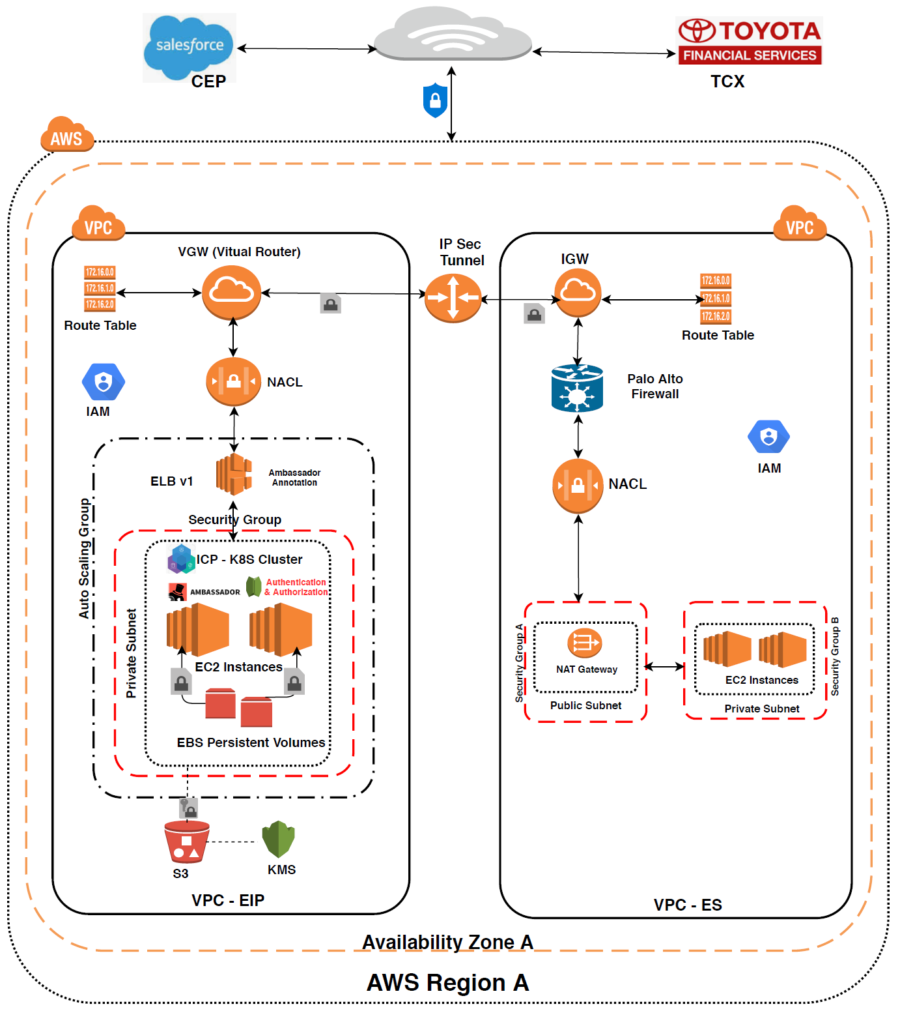
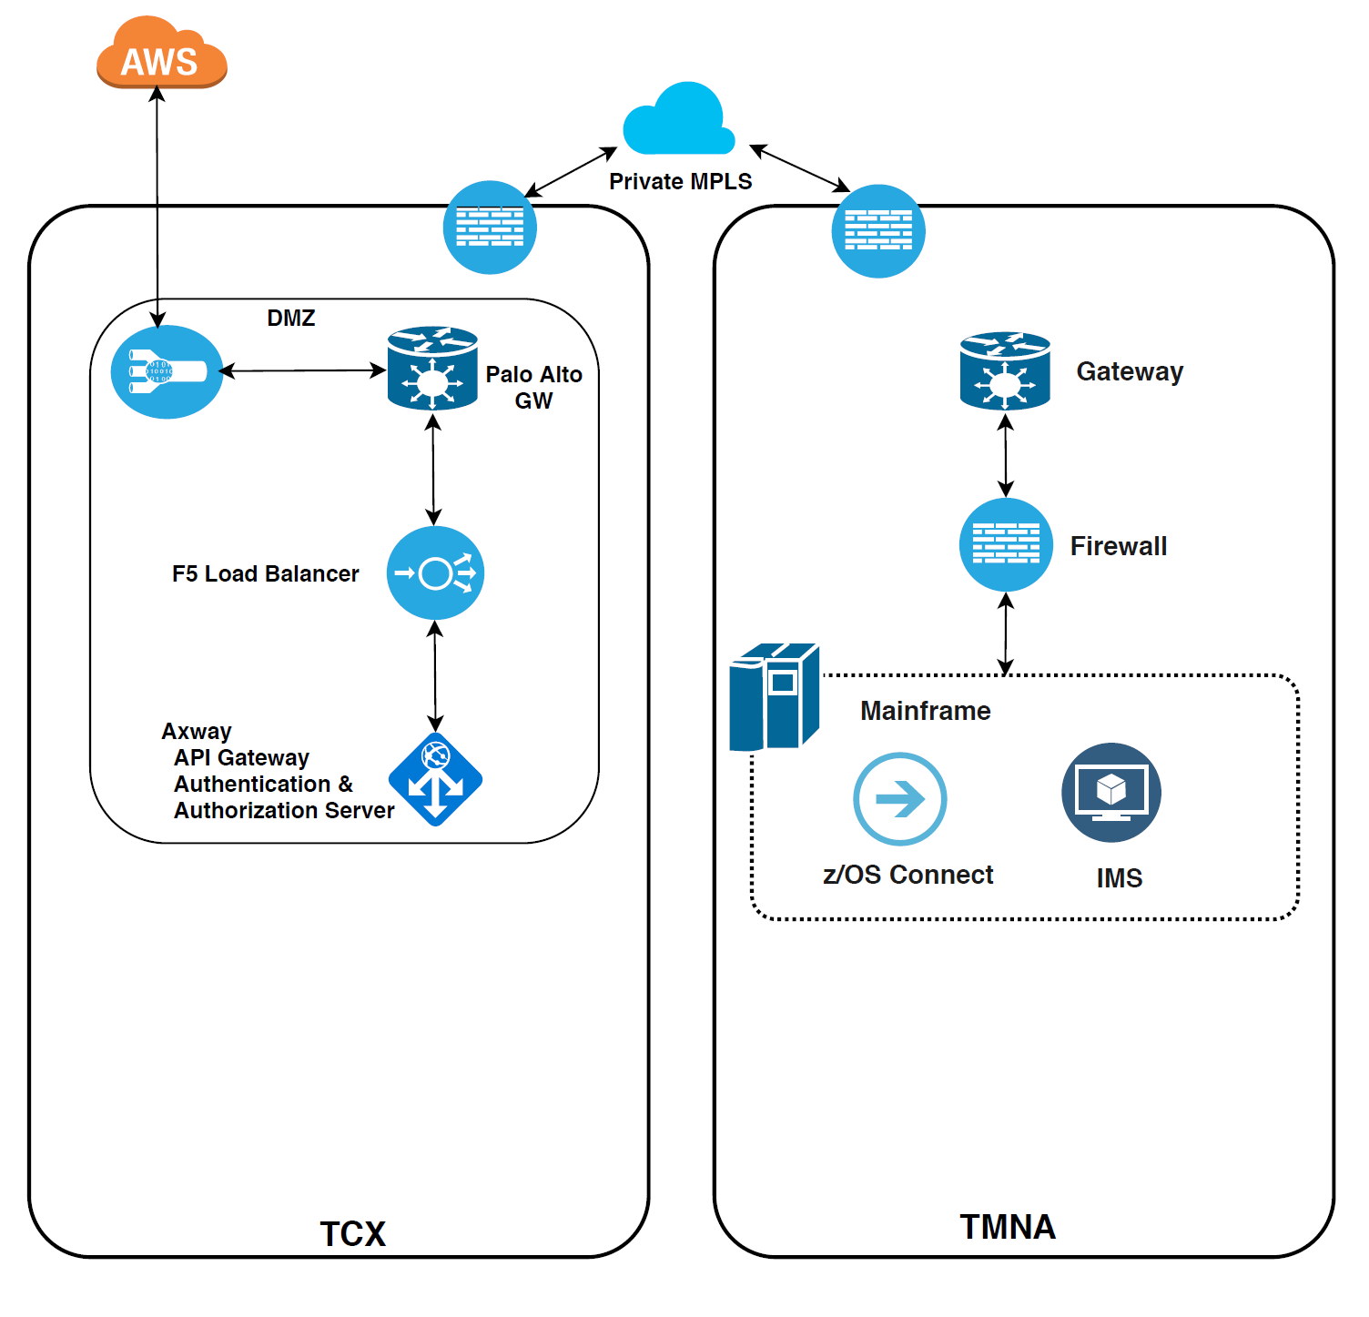
EIP Security Architecture: Footprint Architecture
Cloud

Slide 11

Copyright © 2012-2018 Steerwise Inc. All Rights Reserved.
Steerwise Inc. disclaims all warranties with regard to this material and contents herein, including all implied warranties of suitability and fitness for any particular purpose. In no event shall Steerwise Inc. be liable for any special, incidental, indirect or consequential damages or any damages whatsoever resulting from loss of use, data or profits, whether in an action of contract, negligence or other tortious action, arising out of or in connection with the use or inability to use this material or performance of this material.
Some contents in this material is protected by copyright, and permission must be obtained from the owner prior to any prohibited reproduction, storage in a retrieval system, or transmission in any form or by any means, electronic, mechanical, photocopying, recording or likewise. No one is allowed to remove or modify proprietary markings or proprietary legends, logos, trademarks, trade secrets, copyright and proprietary rights notices from this material under any circumstances.
The copyrighted material is intended for use by the licensed customers only. None of the information found here can be used for commercial gain of any kind including resale or reproduction for profit. No one is allowed to copy or sell or distribute any of the material or contents thereof or any derivate works to any party as their own, or of any other party, without explicitly obtaining either a commercial or non-commercial license from Steerwise Inc.
Business Technology Architecture® is a registered trademark of Steerwise Inc. Business Value First™, Innowise™, Alignwise™, Performwise™, Meaning-Oriented-Modeling™, Meaning-Oriented-Integration™, Business Being™, Data Efficacy & Data Excellence™, Data Semantic Analyzer™ are trademarks of Steerwise Inc.
Any inquiries regarding this material, requests for usage rights for the material or contents included herein, should be sent by email to info@steerwise.com

